Slide 1
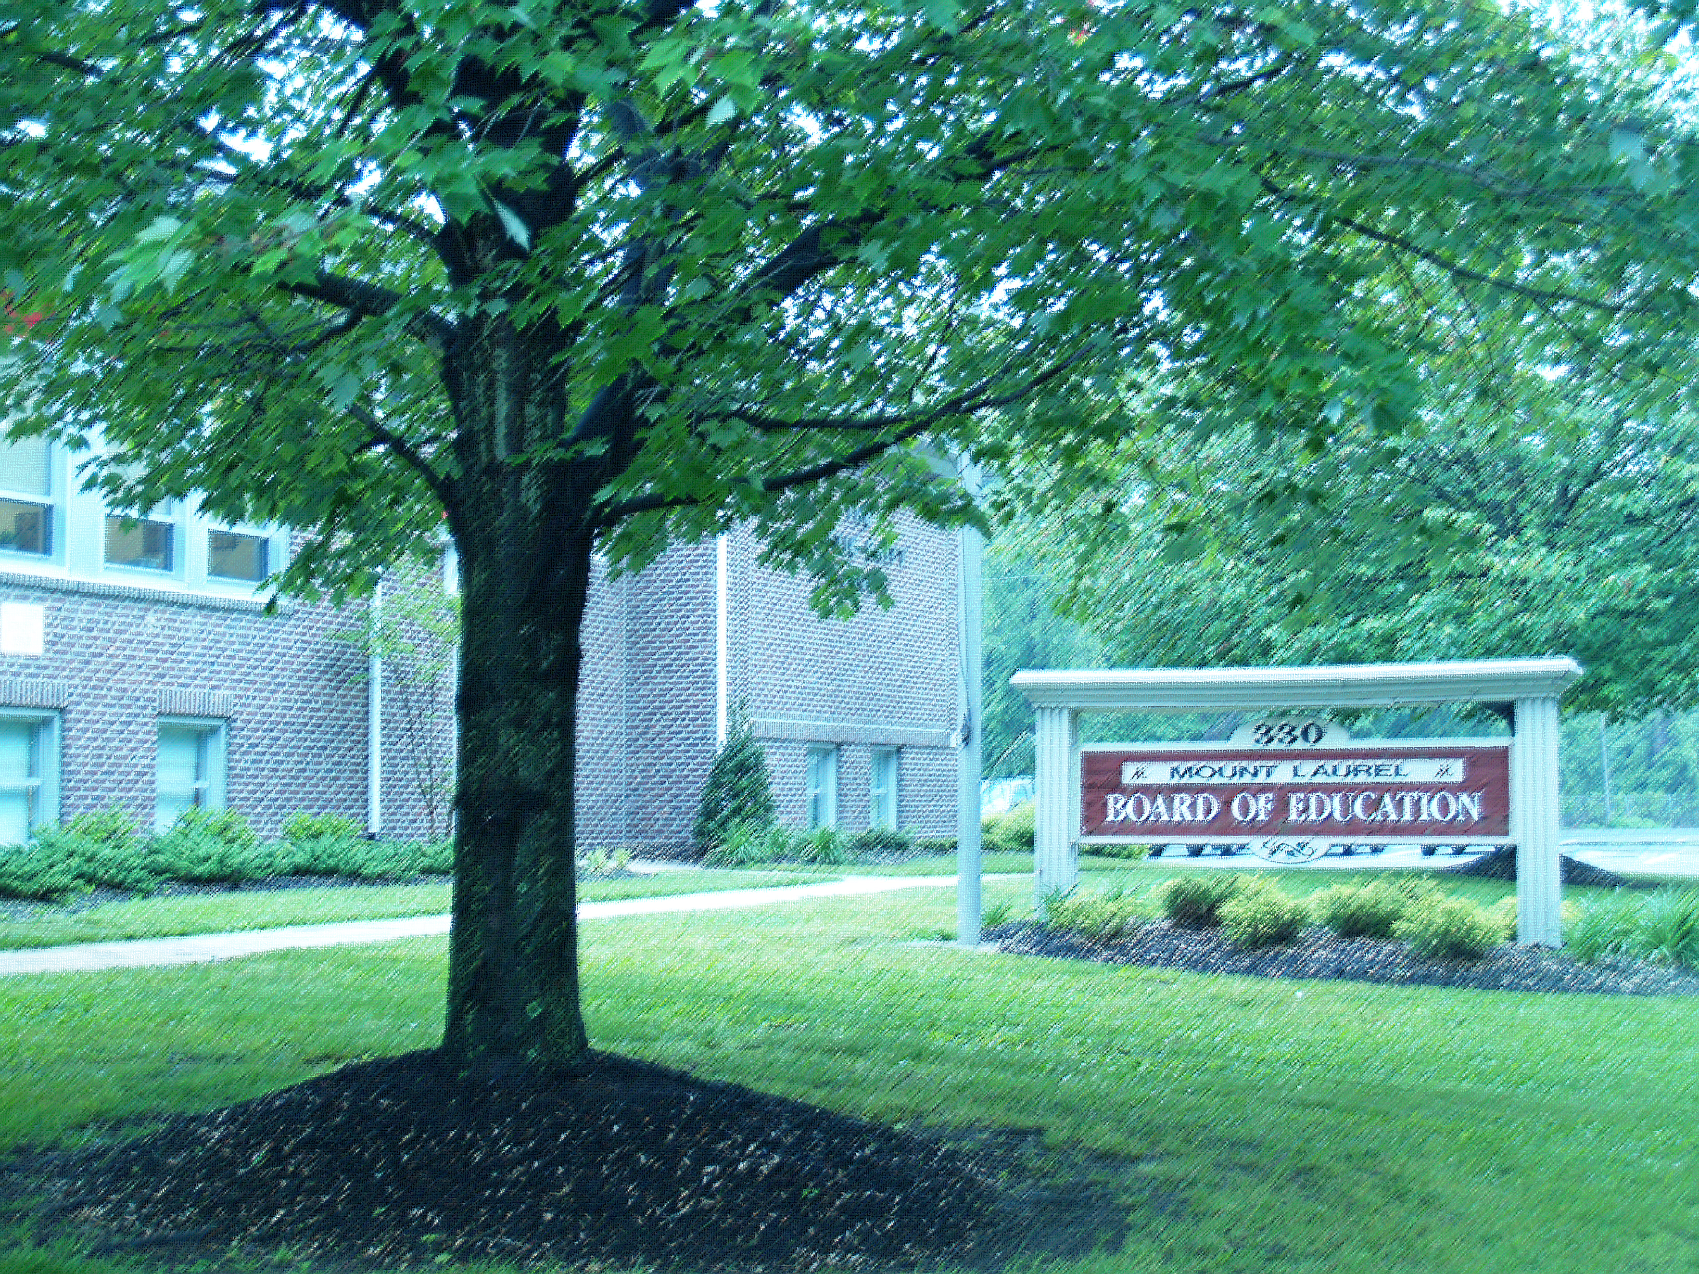

Mount Laurel Schools
Proposed Budget
2026-2027
Dr. George J. Rafferty, Superintendent
Robert F. Wachter Jr., School Business Administrator
April 28, 2026

Slide 2
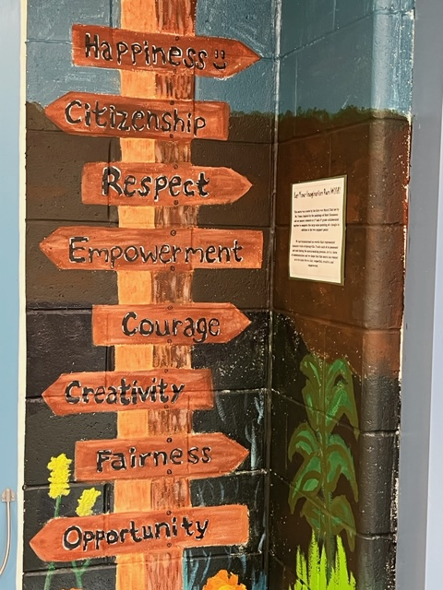
Some Quick Facts:
Enrollment: 4,751
Free or reduced-price lunch: 19.28%
(802 Free Lunch, 114 Reduced Price)
Special Education: 12.13% (576 Students)
Oldest school built in 1954
Newest school opened in 2001
Maintain total of 669,928 square-feet of space
483 certified staff members
379 support staff members

Slide 3
PTO & Public Education Fund Support
After-School Clubs & Extracurricular Activities
Field Trips
Teacher Mini-Grants for Innovative Projects
Assemblies & Ongoing School Support
Family Events and Activities
Staff Recognition
Technology Improvements

Slide 4
Included in Proposed Budget
Curriculum
Supplies and Materials
Classroom Materials and Resources
Digital Instructional Materials
Digital Books & Materials
Classroom Libraries (Grades K-4)
Math Program Resources (K-8)
STEM Materials and Supplies
New Algebra I and Geometry Program Resources
World Language Resources
Science Materials & Supplies
Visual and Performing Arts Materials
ESL Resources
Elementary School Gym Equipment
GAP Screeners/Dyslexia Screeners
Professional Development:
Problem Based Teaching and Learning
Mathematics
Next Generation Science Standards PD
Teachers College Reading and Writing Project, Columbia University (Grades K-8)
Professional Development on Inclusive and Equitable Practices
Orton Gillingham
Teaching Strategies PD

Slide 5
Included in Proposed Budget
Curriculum Writing
School Counseling (5-8)
English Language Arts (K-8)
Social Studies (6-8)
Science (K-2) and New STEAM Elective (7-8)
Math (3-8)
Report Card Revisions for standard alignment
Preschool Education
> Continued Expansion of the Full Day 3yr. and 4yr. Programs
Projecting to serve 639 Preschool Students
Continued partnership with Community Childcare Providers
Continued partnership with Montclair State University in the
NJ Preschool Inclusive Education Project
Continued Professional development
Technology
Student Chrome Book Replacements
Upgrading Comcast Internet and WAN Speeds
Go Guardian for Chromebooks
PowerSchool, Online Student Registration & Data Warehouse
Remote Management and Anti-Virus/Cyber Security Trainings
Teacher Laptop Replacements
Interactive TV’s & Projector Replacement and Installation

Slide 6
Capital Improvements In Budget
Springville Hallway Tile Replacement
Carpet Replacement with Tile at Hartford/Springville
Tile Replacement at Harrington C-Wing
Carpet Replacement at Hartford and Harrington Libraries
Painting at all Schools
Water Fountain Replacement
All Purpose/Gym’s Duct Work cleaning
Hartford Main Office Upgrades/ Security
Larchmont & HMS Faculty Room Upgrades
Playground/Courtyard Upgrades
Hillside Closet/Coat Room Door Replacement
Refinish Gym Floors
Fire/CO2 Alarm Panel Upgrades
Springville Stairwell Window Replacement
Cafeteria Table Replacement/Repairs at Hillside, Countryside, Fleetwood & Parkway
Larchmont Roof Repair (Phase 3)
Purchases
Two 54-passenger buses; Two 24-passenger buses
Ten Live GPS/ Camera System Units
Routing Software System Upgrade

Slide 7
Additional Staffing In 2026-2027 Budget
Please Note:
The 2026-2027 budget sustains the 8th year of our
Full-Day Kindergarten Program in all six elementary schools, based upon projected enrollment increases and the 5th year of Full Day Preschool.
Replacing current Staff (Retirees/Resignations)

Slide 8
Revenue History
State Aid (General Fund):
2009/10 5,809,040
2010/11 2,839,448
2011/12 4,028,712
2012/13 4,265,312
2013/14 4,265,312
2014/15 4,342,882
2015/16 4,342,882
2016/17 4,433,463
2017/18 4,512,427
2018/19 4,836,580
2019/20 5,021,935
2020/21 5,143,408
2021/22 5,674,157
2022/23 6,482,340
2023-/24 7,364,000
2024-2025 7,636,890
2025-2026 8,095,100
2026-2027 8,580,806
Federal Aid: Budgeted 75% of IDEA and NCLB Fiscal Year 2025 allocations

Slide 9
Revenue History
Debt Service Aid:
2015/16 732,392
2016/17 732,635
2017/18 728,912
2018/19 727,023
2019/20 1,165,533
2020/21 964,598
2021/22 978,421
2022/23 976,741
2023-2024 974,686
2024-2025 972,257
2025-2026 967,660
2026-2027 904,699
Assessment for SDA:
2017/18 (83,924)
2018/19 (83,924)
2019/20 (83,924)
2020/21 (83,924)
2021/22 (83,924)
2022/23 (83,924)
2023-2024 (83,924)
2024-2025 (83,924)
2025-2026 (83,924)
2026-2027 (83,924)

Slide 10
Historical Tax Levy Data
Nine - Year Rate of Tax Levy Increase:
2017 - 2018 2.00%
2018 - 2019 2.78%
2019 - 2020 2.24%
2020 –2021 2.85%
2021 –2022 1.86%
2022 - 2023 1.88%
2023 – 2024 2.00%
2024 - 2025 2.96% 2025 - 2026 4.98%
Proposed….2026 - 2027 5.82%

Slide 11
Budget Comparison: Total Budget
2025-2026
2026-2027
Budget Growth - $1,827,445 or 1.69%

Slide 12
Where The Money Comes From

Slide 13
How The Money Is Spent

Slide 14
Cost-Saving Measures
School Health Insurance Fund – 69 Districts .
Burlington County Joint Insurance Program Fund - 45 Districts.
Burlington County Co-Op for the purchase of fuel, heating oil and rock salt.
NJ ACT Program for phone service.
NJ ACES Program for electric & natural gas, estimated savings -
(Projected savings $62,000 for the current year!
Federal Universal Service Program (E-Rate) for savings of $70,561
Educational Data Services Co-op for supplies saved $377,483 in 2025-26
Five-year savings of $1,373,734 for Ed Data

Slide 15
Cost-Saving Measures
Interior Lighting/HVAC Savings moving forward - $194,000
Exterior Lighting retrofit to save energy, reduce carbon footprint, expected to save $20,112 annually
Solar projects at all Eight Schools:
Mount Laurel Schools has a total of 1,356kW of Direct Current Solar Electric spread out over eight schools.
All eight systems combined produce approximately 1,899,098 kWH a year. That’s equal to the amount of energy used by 224 average-sized households.
The amount of Green House Gas (CO2) saved/offset by our solar systems is equal to 293 passenger cars driven for an entire year.
The district saves approximately $220,000 a year on its electric bills for those eight schools, or 31-percent of the cost of their combined usage.
In addition, the district will receive over $167,379 this year in Solar Renewable Energy Credits (SREC’s). Savings of $ 419,314 Since July 2024!

Slide 16
Appropriations
 | 2025-2026 | 2026-2027
General | 89,736,975 | 93,550,496
Special | 14,738,648 | 12,894,647
Debt Service | 3,402,475 | 3,260,400
Total | 107,878,098 | 109,705,543
Difference | $1,827,445 | 1.69% Increase

Slide 17
2026-27 Proposed Tax Levy Calculation
2018-19 Tentative Tax Levy Calculation
 | 2025-26 Tax Levy | 2026-27 Proposed Tax Levy
General Fund | 72,674,274 | 77,544,942
Debt Service Fund | 2,060,020 | 2,122,981
Total Tax Levy | 74,734,294 | 79,667,923
2025-2026
$241,292 (Average Home)
x .01271 (Local School Tax Rate)
$3,066.82
2026-2027
$ 241,292 (Average Home)
x .01345 (Local School Tax Rate)
$3,245.37
Based on the average home in Mount Laurel, assessed at $241,292, the increase for local school taxes next year would be $178.55 (or 5.82%).

Slide 18
Comparative Spending Guide
Indicator Mount Laurel Comparable Districts State Average 2026-27 (K-8 with 751+) 2023-2024
Total cost per pupil $19,217 $20,539 $21,199
Total administrative cost $1,671 $ 1,960 $ 2,172
Admin. salary & benefits $1,395 $ 1,605 $ 1,700
The NJ DOE’s Administrative Spending Threshold for our region is $2,762 per pupil
We are $3,878,988 million below the regional limit in Total Administrative Costs
Our Transportation Efficiency Rating is 1.873% as compared to the 1.20% state baseline.
Source: NJ Department of Education Taxpayers’ Guide to Education Spending, 2024-2025

Slide 19
This Year’s Budget Process
Board Finance Committee – November to April
Tentative Budget Presentation & Board Vote – 3/24/26
Submission to NJDOE County Office for review & approval
Advertise budget on District Website – 4/23/2026
Public Hearing & Final Board Vote – 4/28/2026 Certification & Submission to NJDOE
User-friendly budget posted online
Budget effective July 1, 2026 – June 30, 2027

Slide 20


Slide 21
Stay In Touch With The Latest News
www.mtlaurelschools.org

Slide 22
Mount Laurel Board of Education
Danielle Stuffo , President
Melissa DeClementi, Vice President
Roger Gibson Susan Lovato
Tara Hall Jade Moustakis
Shamara Ijames Jonathan Paradise
Sapna Rustagi
Administration
Dr. George J. Rafferty
Superintendent of Schools
Mridula Bajaj
Assistant Superintendent of Curriculum & Instruction
Robert F. Wachter Jr.
School Business Administrator
Dr. Diane Willard
Director of Child Study Team
James DeSimone
Director of Early Childhood Education
Aja Thomas
Director of Human Resources

