Slide 1
Smart Schools Initiative
Preliminary
School Board Presentation
January 2025

Slide 2
Smart Bond Initiative
Passed by New York Voters in November of 2014
Awarded $2 Billion to all public schools based on enrollment and state aid formula
Andes Central School Allocation is
$87,858

Slide 3
Smart Bond Initiative
A plan was submitted under the previous administration during Covid. That money was never spent, and the priorities are no longer relevant.
Andes Central School Allocation is
$87,858

Slide 4
Rules for these use of these funds
School Networking
Classroom Technology
Community Connection
Pre-K Classroom Improvements
Elimination of Temporary/Trailer Classrooms
School Security and Safety
6 categories

Slide 5
Rules for these use of these funds
You cannot pay salaries
You cannot pay BOCES
You cannot purchase software

Slide 6
Step 1
Administration consults the current NYSED Mandatory Plans and Surveys to establish possible priorities in the approved categories.
Consideration to
Strategic Plan
Technology Plan
Building Condition Survey

Slide 7
Step 2
The district has established a volunteer Smart School Planning Committee to review all proposals and recommend them to the Board of Education.
Student(s)
Staff
Administrators
Board of Education member
Parent(s)
Community

Slide 8
Step 2
The committee met a short time ago and is recommending the following priorities as he district’s supplemental plan.
Student(s)
Staff
Administrators
Board of Education member
Parent(s)
Community

Slide 9
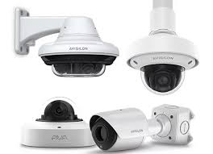
Andes Supplemental Proposal
Purchase High Tech security devices to improve the building security at Andes Central School.
Including:
Video Security Cameras

Slide 10
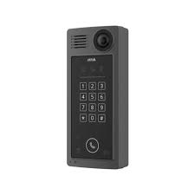
Andes Supplemental Proposal
Purchase High Tech security devices to improve the building security at Andes Central School.
Including:
Door Security

Slide 11
Next Steps
Board of Education is asked to review the committee recommendations and possibly adopt the preliminary supplemental plan.
The proposed Smart Bond Investment Plan is published on the school district web site with an email address for public comments for a minimum of 30 days.

Slide 12
Next Steps continued
After 30 days the Smart Bond Investment Plan comments are reviewed in by the Board of Education.
Board of Education possibly approves final plan for submission to NYSED.
Final NYSED review could be six to 12 months.

Slide 13
Please Email Questions and Comments to;
Samantha Candreva
SCandreva@Andescentralschool.org

